Slide 1
Week 3 (5) – Introduction to Brute Force
CST370 – Design & Analysis of Algorithms
Dr. Byun
Computer Science

Slide 2
Lecture Objectives
After completion of this lecture, you will be able to
  explain the basic idea of the brute-force approach in problem solving.
  use simple sorting algorithms to enumerate several items in order.

Slide 3
Chapter 3: Brute Force and Exhaustive Search
3.1 Selection Sort and Bubble Sort
3.2 Sequential Search and Brute-Force String Matching
3.3 Closest-Pair and Convex-Hull Problems by Brute Force
3.4 Exhaustive Search
3.5 Depth-First Search and Breadth-First Search

Slide 4
Introduction to Brute-Force
Brute force is a straightforward approach to solving a problem, usually directly based on the problem statement and definitions of the concepts involved.
  In other words, "Just do it!".
Often, the brute-force strategy is indeed the one that is easiest to apply.
  Though rarely a source of clever or efficient algorithms, the brute-force approach should not be overlooked as an important algorithm design strategy.

Slide 5
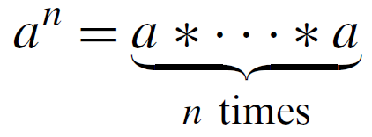
Example
Assume that you should compute a^{n} for a nonzero number a and a nonnegative integer n.
  Example: 3⁵ = 3 * 3 * 3 * 3 * 3
  By definition of a^{n}, you can simply multiply as below:

Slide 6
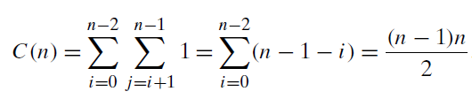
<<< Course Instruction (1 of 2) >>>
Read pages 97-101 in the textbook and proceed to the next slide.
  Basic ideas of selection sort and bubble sort are straightforward.
  But getting time efficiency from formulas in the textbook may not be easy.
  For example, this is the number of key comparisons for the selection sort algorithm.

Slide 7
<<< Course Instruction (2 of 2) >>>
If you can not follow it, you can think like this way.
  When the outer index i is 0, the inner loop with index j is executed from 1 to (n-1). So it runs (n-1) times.
  Similarly, when the index i becomes 1, the inner loop is executed for (n-2) times.
  As the index i increases, the execution of the inner loop is reduced by one.
  Therefore, the total number of comparisons becomes (n-1) + (n-2) + (n-3) + ... + 2 + 1.
  So, it becomes ((n-1) * n) / 2.
  If you do not understand why " (n-1) + (n-2) + ... + 2 + 1" is ((n-1) * n) / 2, try this video again.
  https://www.youtube.com/watch?v=qrvcWgdkGi8

Slide 8
Puzzle: Angle of Two Clock Hands
We know that the angle of the two clock hands is 90 degrees at 3:00(PM).
  Then what is the angle of the two clock hands when the time is 3:15 (PM)?

Slide 9
Important Note
Do not see the answer immediately on the next page.
Hint
  When the long clock needle moves, the shorter one also moves. But it moves more slowly.
  Recall that one hour is 60 minutes.

Slide 10
Solution
It will be 7.5 degrees at 3:15(PM).
There are 12 hours on the clock. So the little needle moves 30 degrees for one hour.
And also, 15 minutes is a quarter of 60 minutes.

Slide 11
<<< Course Instruction >>>
This lecture is over.
  If you do not understand any part in the lecture, study it again.
The deadline of homework 3 is Tuesday, Jan 21 at 11:55 pm.
  Next week's lecture notes (= week four) will be available on Jan 22 (Wed) around 10:00(AM).
  Note that Midterm-I is on Jan 25 (Sat) from 10:00(AM) to 12:30(PM).

